Slide 1
Excel Basics
Topic 2
Lesson 1 –Excel Basics
Modified from originals created by Martin Schedlbauer, Peter Douglass and Peter Golbus

Slide 2

CS1100: Let’s smash the Excel stereotype
https://www.youtube.com/watch?v=k2CSZGegKnY

Slide 3
Spreadsheets
Spreadsheets are among the most useful technical business applications.
Principally used for calculations and manipulation of tabular data.
Common spreadsheet applications:
Microsoft Excel
Google Sheet
Apple Pages

Slide 4
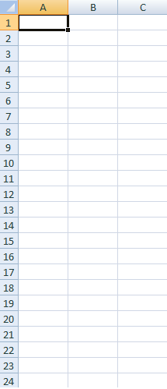
Spreadsheet Layout
Tabular layout arranged in rows and columns.
Columns are labeled with letters
Rows are labeled with numbers
Cells are at the intersection of rows and columns
Example cell reference: A3, C9
Cells can contain:
Numbers, dates, text, or other data
Formulas using functions and cell references

Slide 5
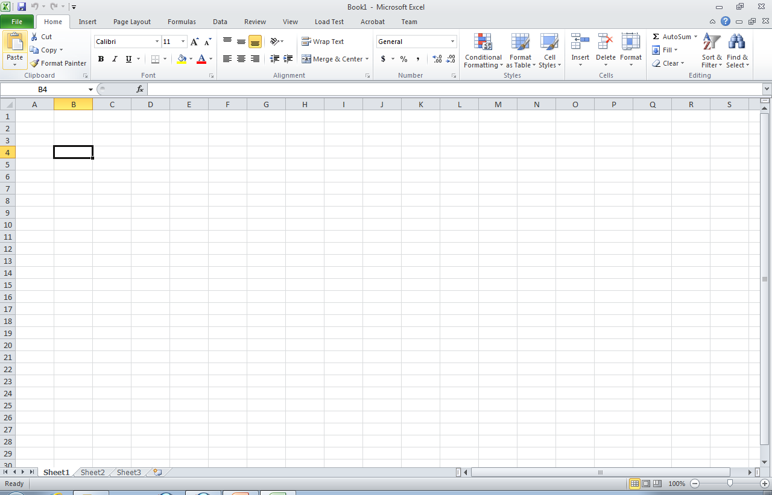
B4 Cell Selected
Cell Reference

Slide 6
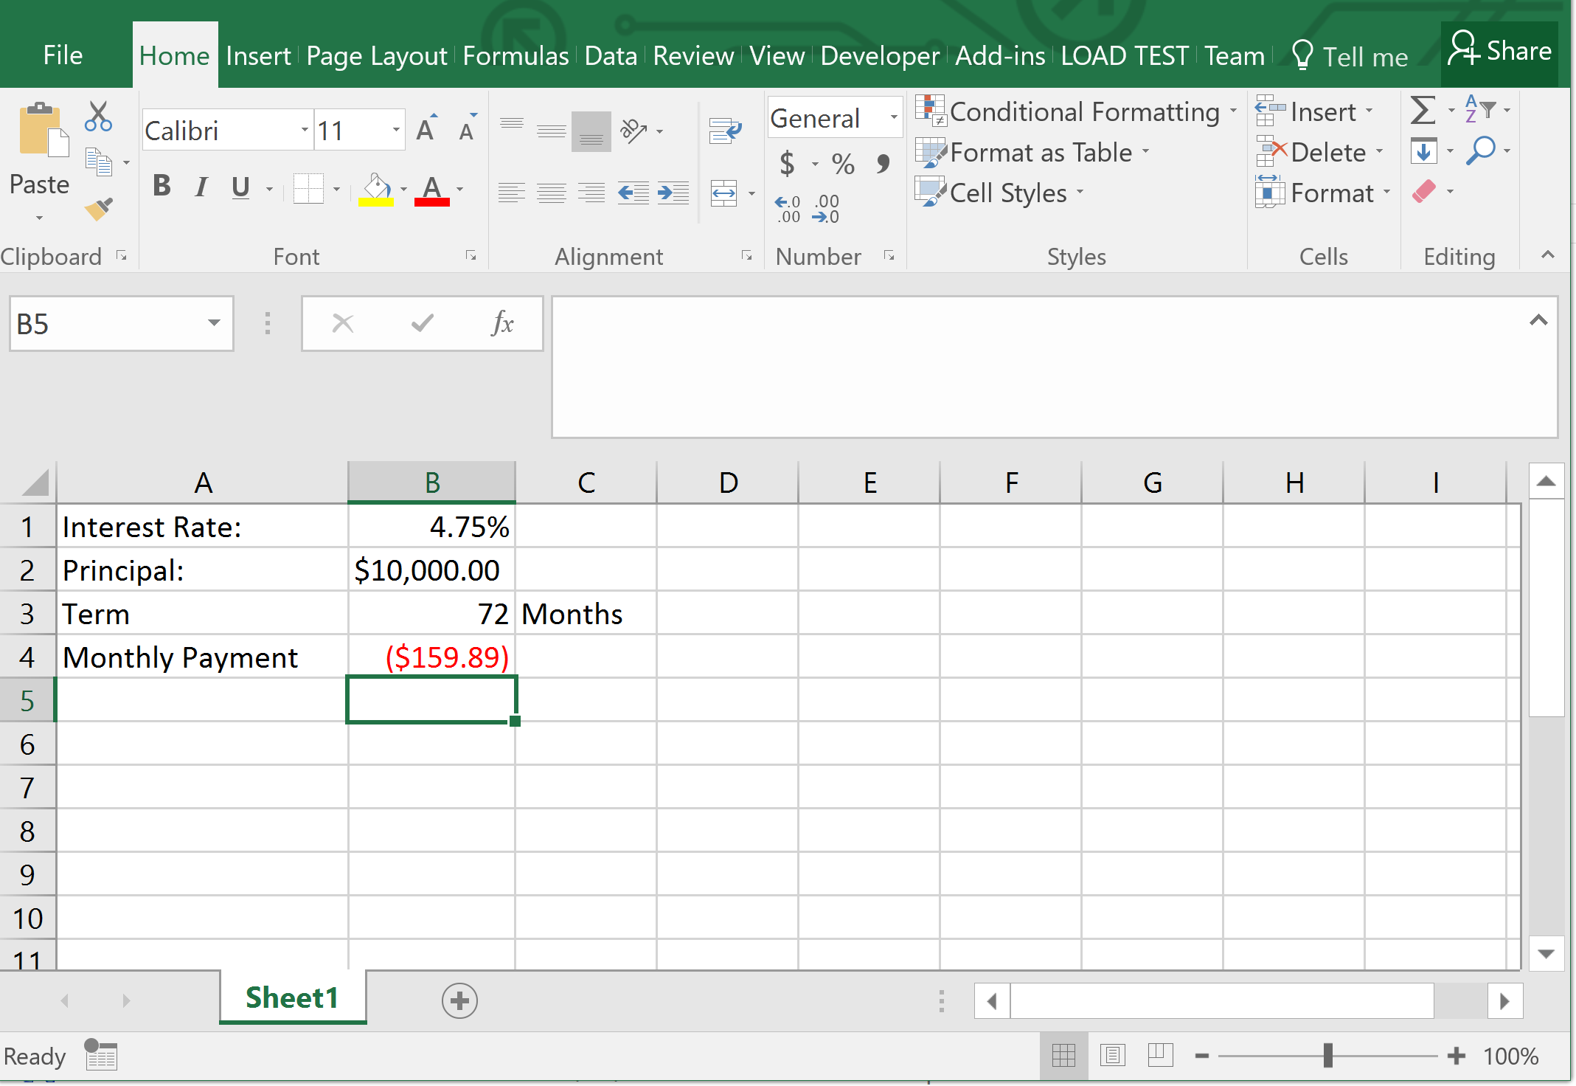
Microsoft Excel 2016

Slide 7
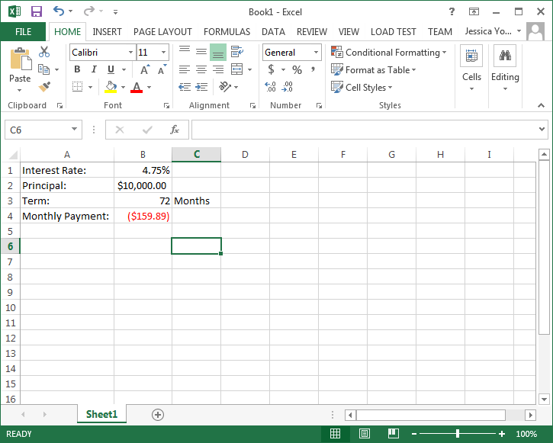
Microsoft Excel 2013

Slide 8
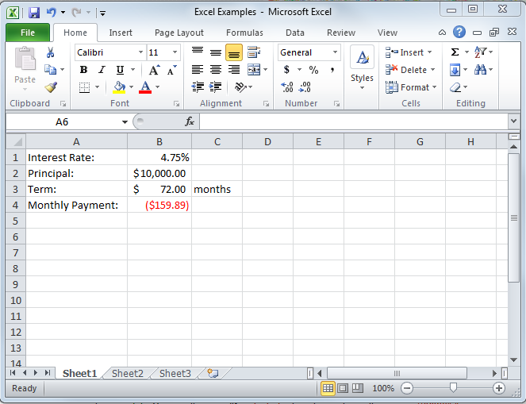
Microsoft Excel 2010

Slide 9
Cell Ranges
Many functions require cell ranges:
Column Range: A1:A10
Row Range: A5:K5
Matrix: A1:C5

Slide 10
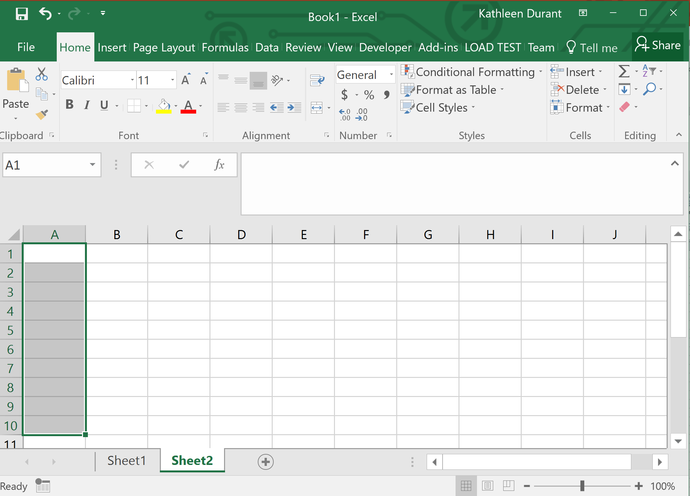
Column Range: A1:A10
Selects cells A1:A10

Slide 11
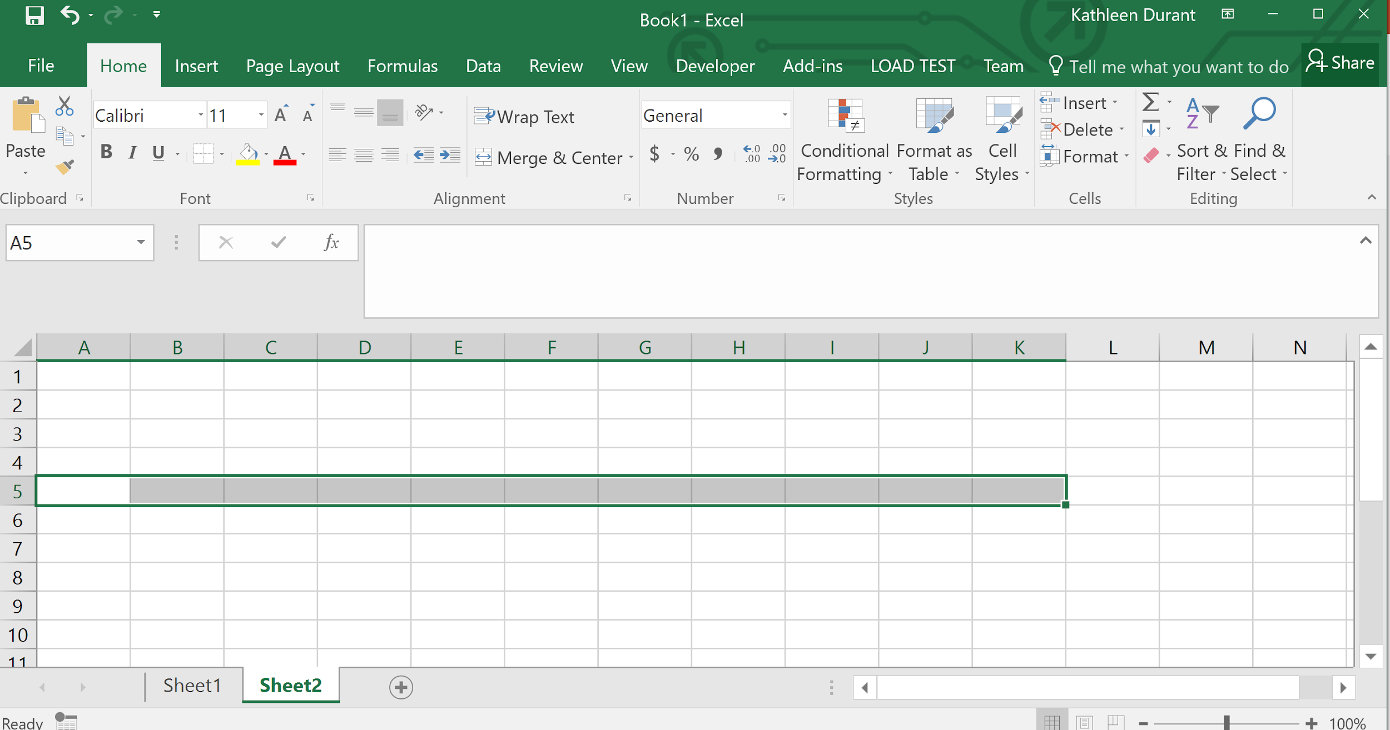
Row Range: A5:K5

Slide 12
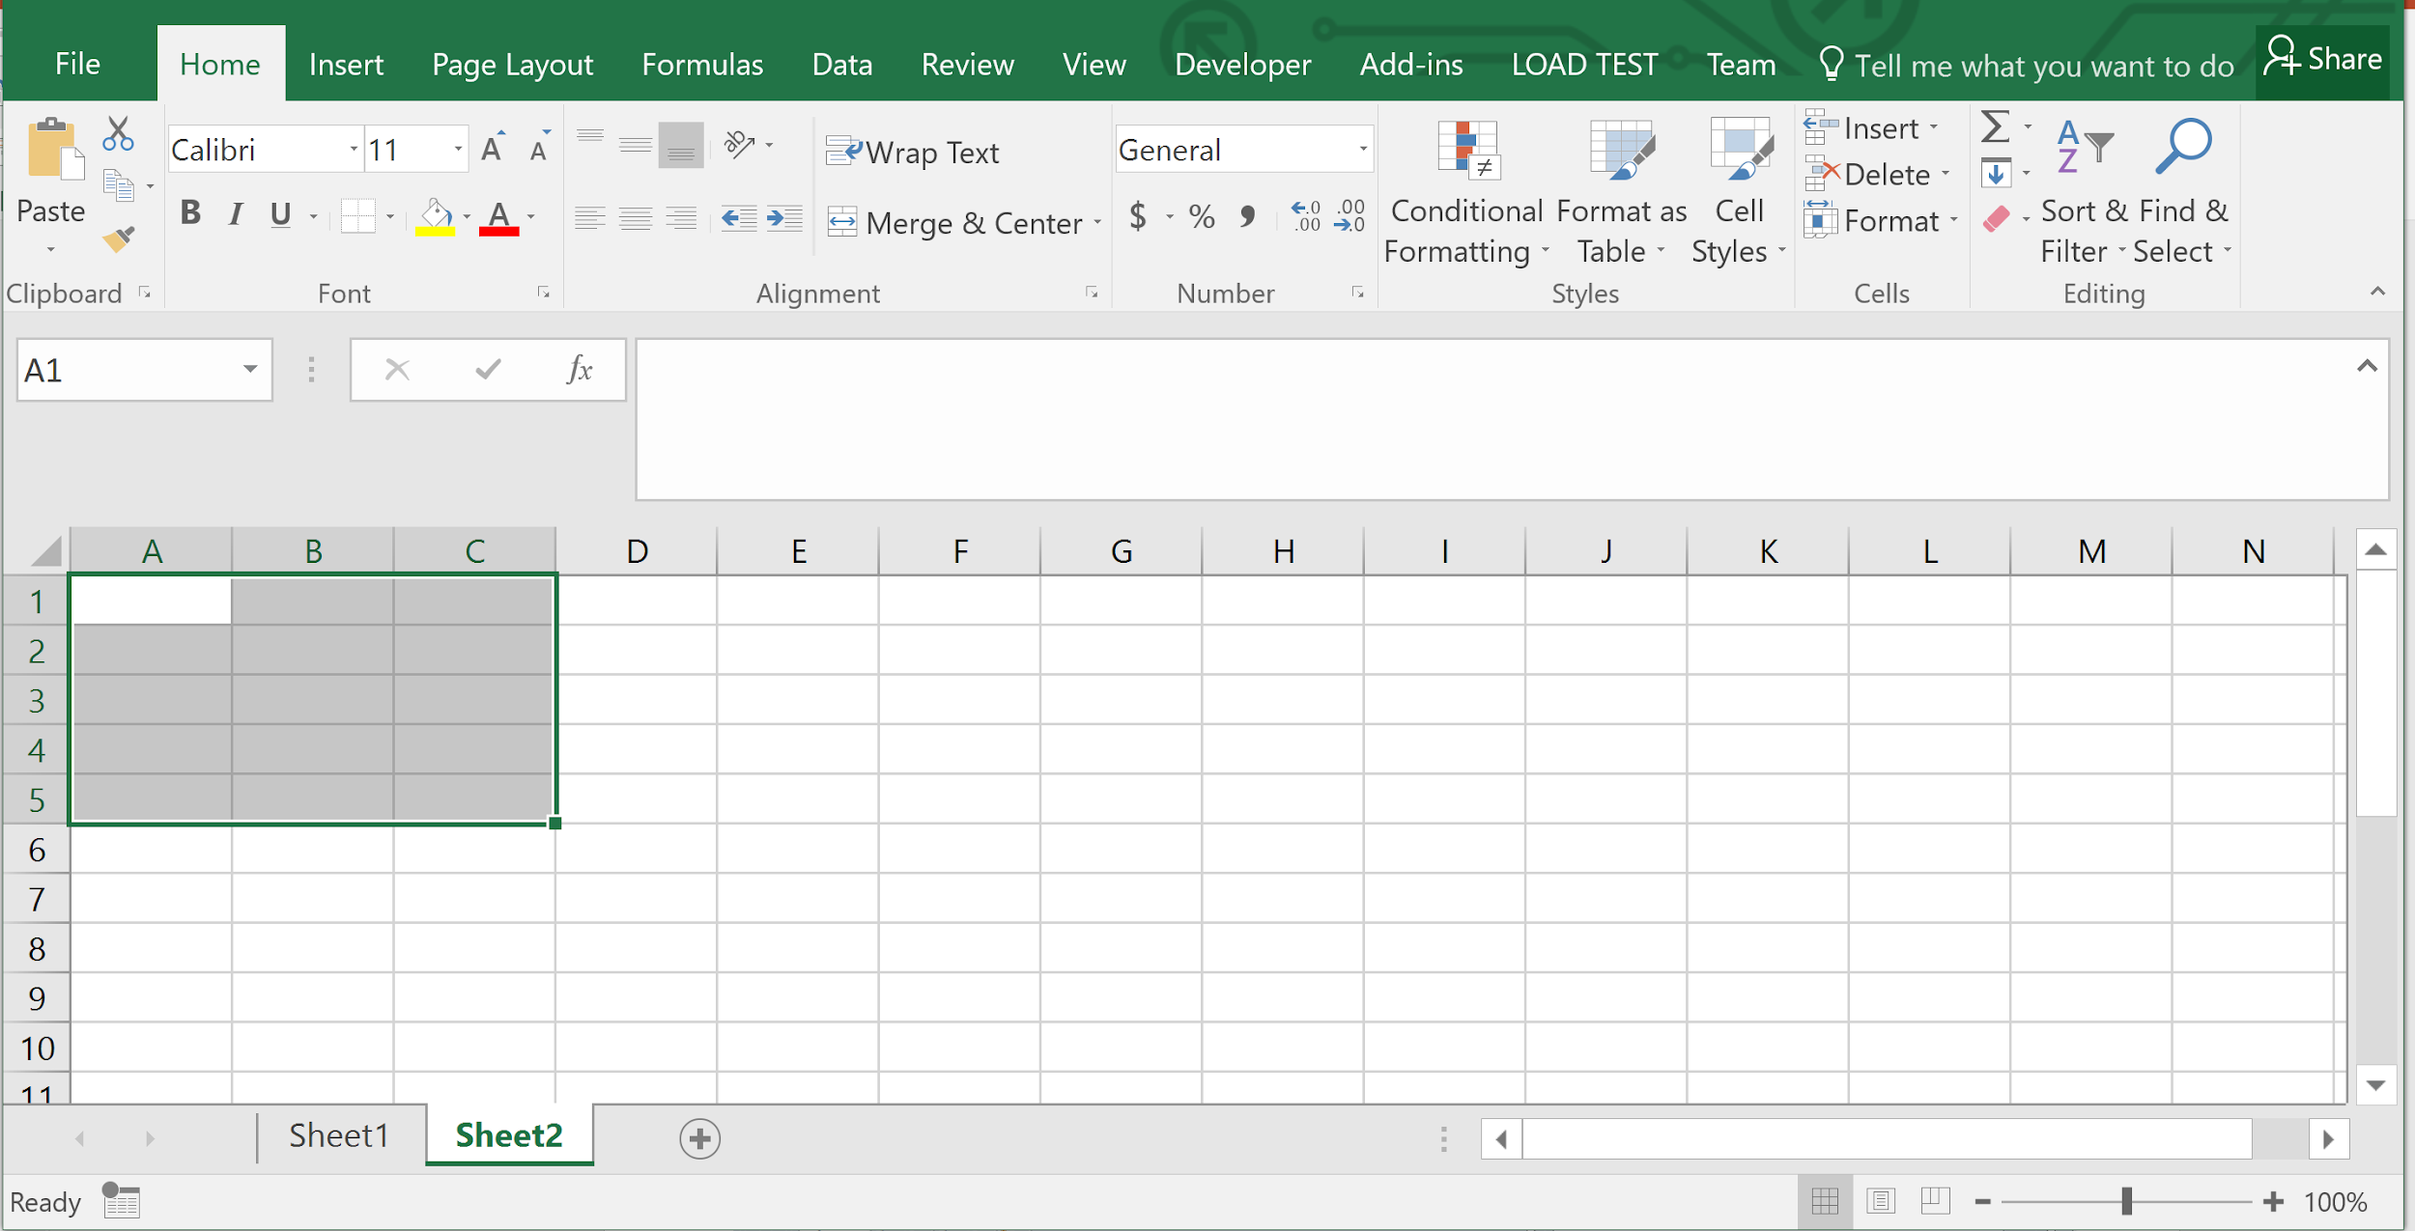
Matrix: A1:C5

Slide 13
Functions
Excel provide thousands of functions to build spreadsheet models:
Financial, e.g., pmt, irr, fv, db
Aggregation, e.g., sum, count, average
Text, e.g., left, mid, trim
Date & Time, e.g., today, time, second
Lookup, e.g., choose, vlookup, match
Logical, e.g., if, not, or
Statistical, e.g., median, correl
Engineering, e.g., bessel, imlog
Trigonometric, e.g., sin, tan, acos

Slide 14
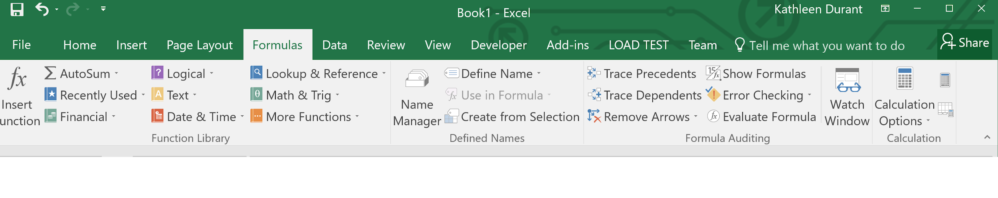
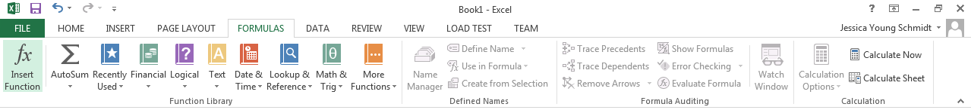
Function Library
2016
2013
2010

Slide 15
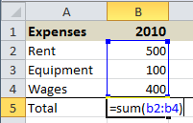
Entering Formulas and Functions
To enter formulas and functions:
start entry with =
Example:

Slide 16
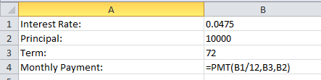
Cell References in Functions
Most functions require parameters.
To keep your model flexible and correct even when the data changes, only use cell references in functions.

Slide 17
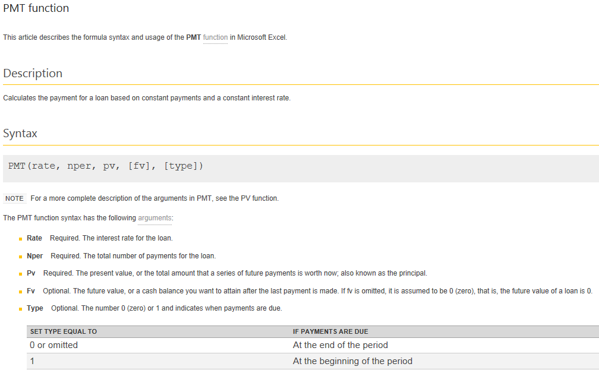
PMT function

Slide 18
Copying Cells
To copy cells:
CTRL+C to copy and CTRL+V to paste
or
Use cell dragging
Cell references are automatically adjusted when copied.
Cell references can be locked $.
$A1:$A5 is not adjusted when column copied
A$1:C$1 is not adjusted when row copied
$A$1 is never adjusted when copied

Slide 19
Copying Formulas
Relative cell references adjust when copying:
Columns references adjust when copying across columns
Row references adjust when copying across rows
Generally, the adjustment is desirable, but sometimes it is not:
Lock cell references by making them absolute references
Use $ before row and/or columns for locking

Slide 20
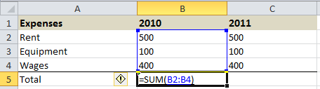
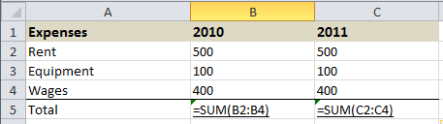
Demo: Copying Formulas
Notice what happens to the cell references when copying from row to row or column to column.

Slide 21
Anchors and Cell Dragging
Formulas can be copied to adjacent cells by dragging.
Dragging changes cell references.
Usually this is what you want, but sometimes it breaks your formulas.
Anchors ($) stop cell references from changing.
But when do you use them?

Slide 22
When to Anchor
Manually rewrite your formula in the cell to the right and the cell below the original cell.
Compare the letters in the original formula to the letters in the formula to the right.
If a letter didn’t change, put a $ before it in the original cell.

Slide 23
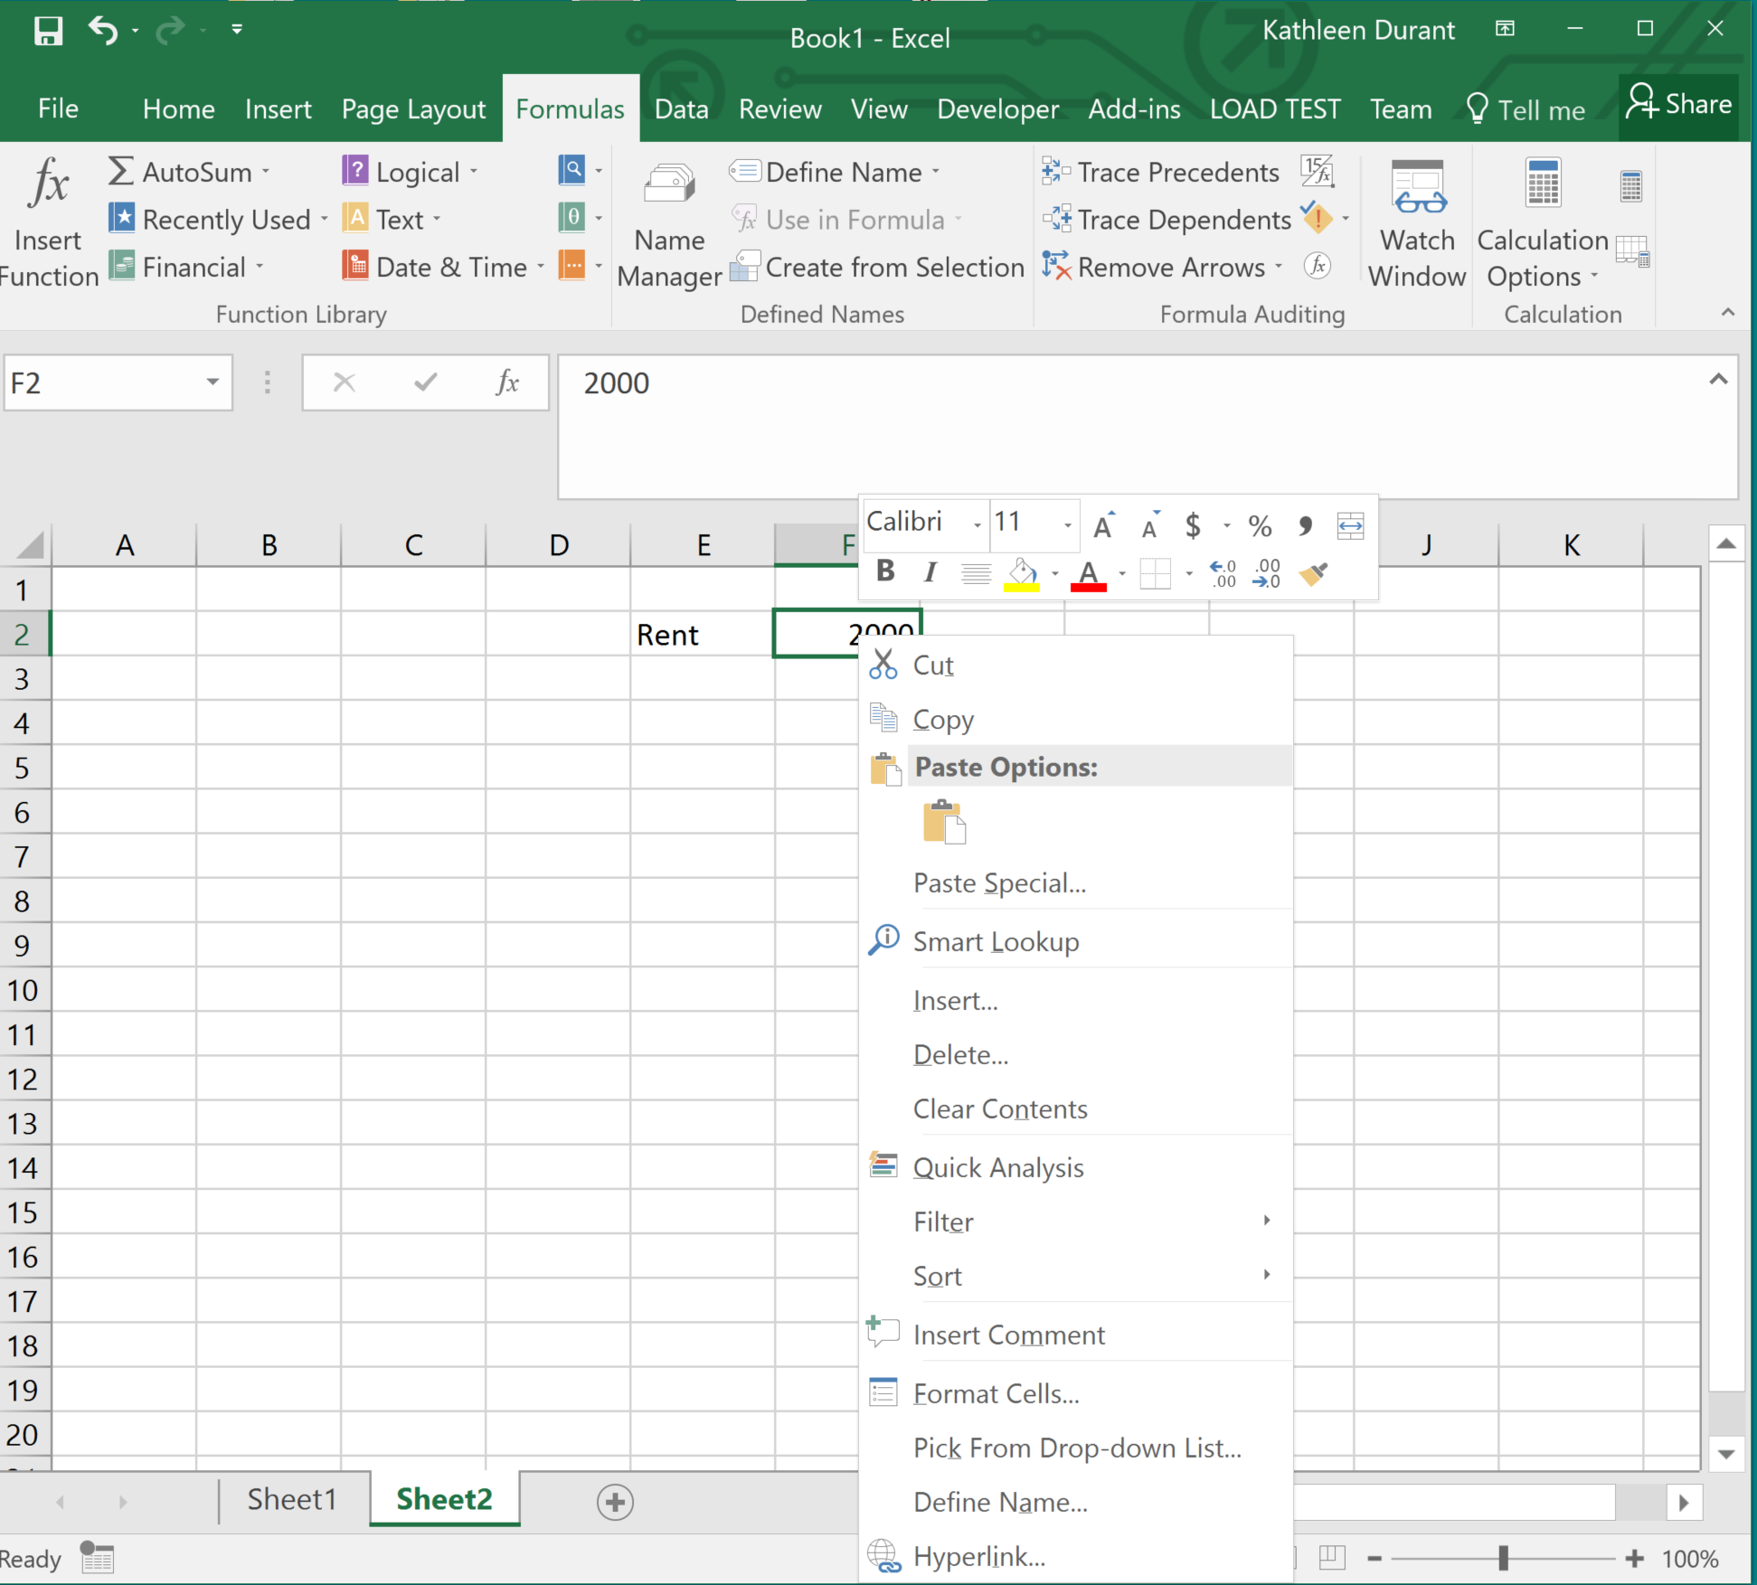
Named Ranges
To make your formulas easier to read, use named cell ranges.
To create a named range:
Highlight cells to include in named range
Click right mouse button on any cell in the selected range for context menu
Choose “Define Name…” and provide name
OR CLICK on the Formula Tab and SELECT ‘Name Range’
Note: named ranges are never adjusted when row or column copied, i.e. both cells and columns are automatically anchored in named ranges.

Slide 24
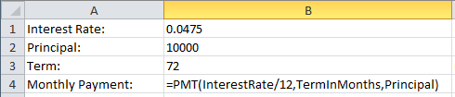
Named Ranges in Functions
Named ranges can make function parameters easier to understand:

Slide 25
Managing Named Ranges
To manage (delete, edit, rename, etc) named ranges
In the Formulas ribbon
Click on Name Manager

Slide 26
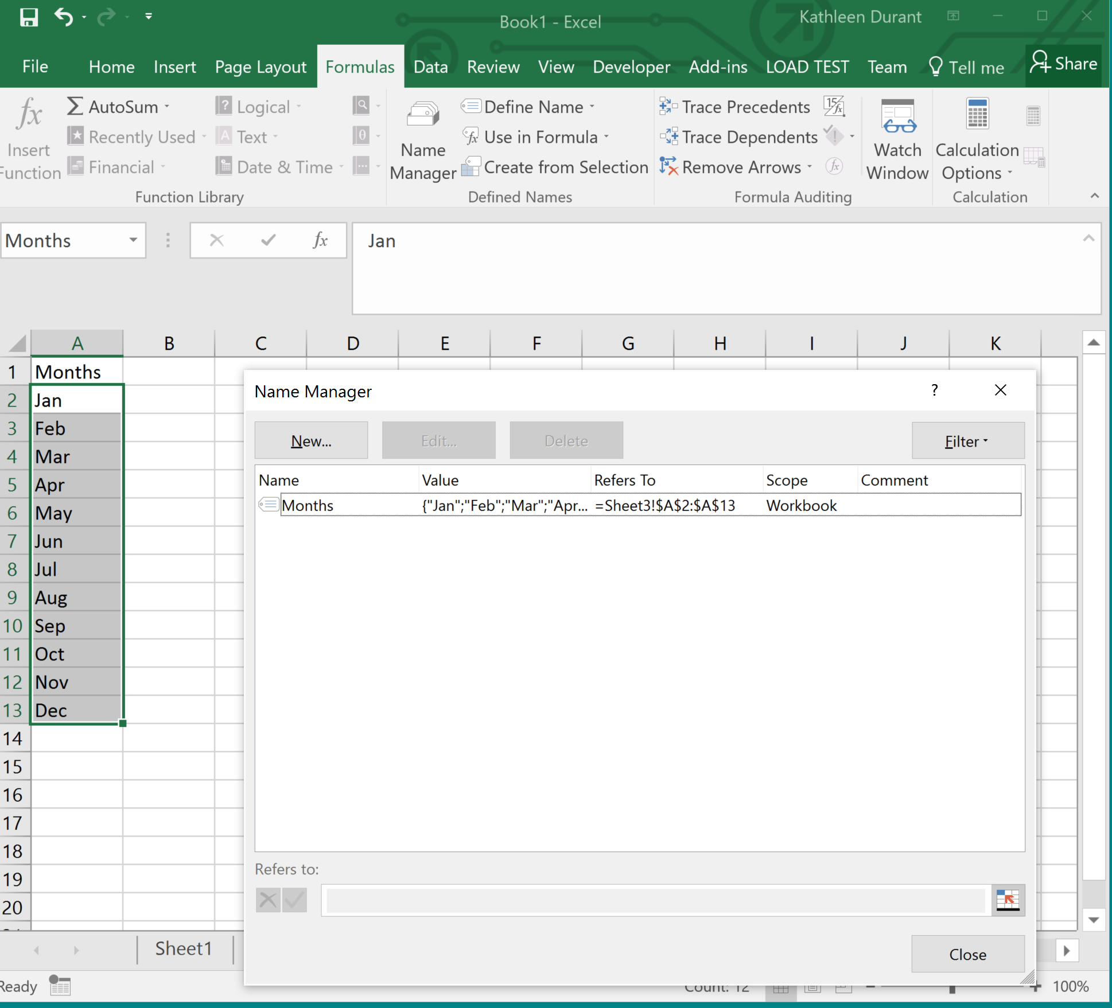
Managing Named Ranges

Slide 27
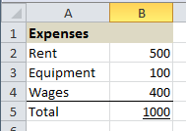
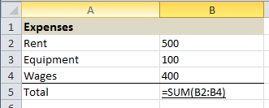
Showing Formulas
To show the formulas in your spreadsheet, press CTRL and ~ at the same time (CTRL+~)

Slide 28
Summary
In this module you learned that:
Excel automatically adjusts cell references when copying formulas
Excel Cell Ranges can be named
Notes:
Note the difference between rounding and formatting precision.

